Slide 1

Computer Networking: A Top Down Approach
Seventh Edition
Chapter 2
Application Layer
Slides in this presentation contain hyperlinks. JAWS users should be able to get a list of links by using INSERT+F7
Copyright © 2017, 2013, 2010 Pearson Education, Inc. All Rights Reserved
Notes:
If this PowerPoint presentation contains mathematical equations, you may need to check that your computer has the following installed:
1) MathType Plugin
2) Math Player (free versions available)
3) NVDA Reader (free versions available)
<number>

Slide 2
Learning Objectives (1 of 7)
2.1 Principles of network applications
2.2 Web and H T T P
2.3 electronic mail
S M T P, P O P3, I M A P
2.4 D N S
2.5 P 2 P applications
2.6 video streaming and content distribution networks
2.7 socket programming with U D P and T C P

Slide 3
Application Layer
our goals:
conceptual, implementation aspects of network application protocols
transport-layer service models
client-server paradigm
peer-to-peer paradigm
content distribution networks
learn about protocols by examining popular application-level protocols
H T T P
F T P
S M T P / P O P3 / I M A P
D N S
creating network applications
socket A P I

Slide 4
Some Network Apps
e-mail
web
text messaging
remote login
P2P file sharing
multi-user network games
streaming stored video (YouTube, Hulu, Netflix)
voice over I P (e.g., Skype)
real-time video conferencing
social networking
search
…
…

Slide 5
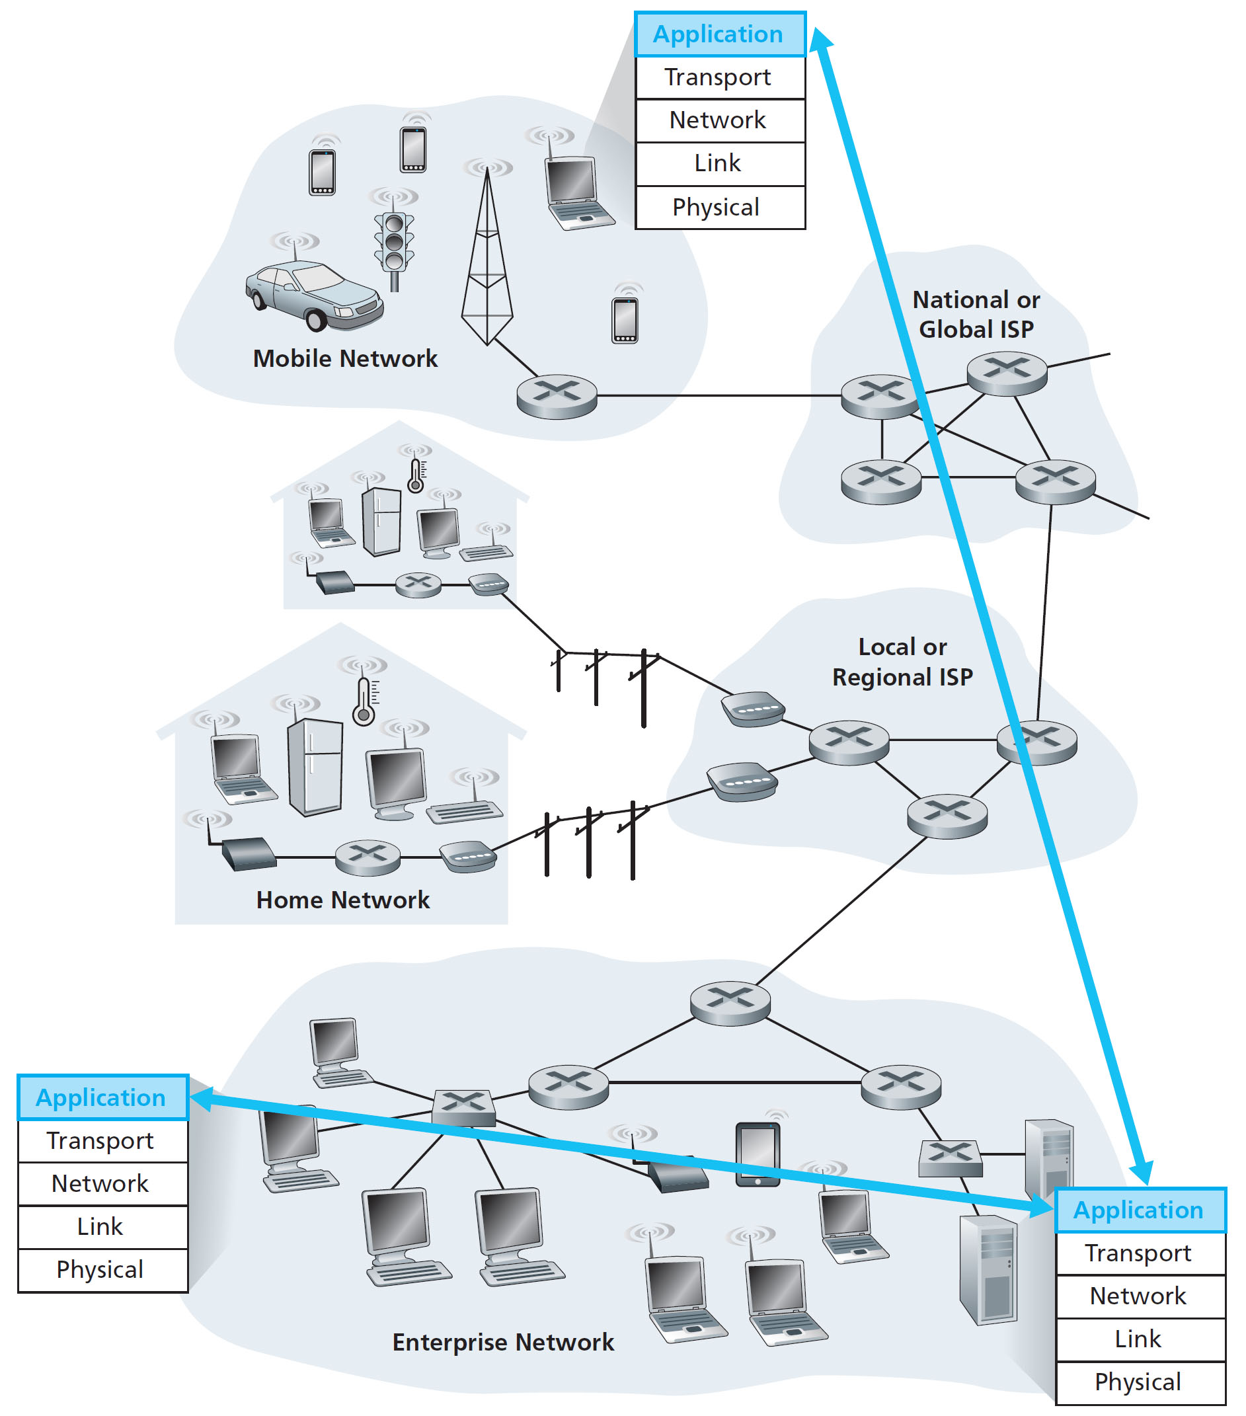
Creating a Network App
write programs that:
run on (different) end systems
communicate over network
e.g., web server software communicates with browser software
no need to write software for network-core devices
network-core devices do not run user applications
applications on end systems allows for rapid app development, propagation

Slide 6
Application Architectures
Possible structure of applications:
client-server
peer-to-peer (P2P)

Slide 7
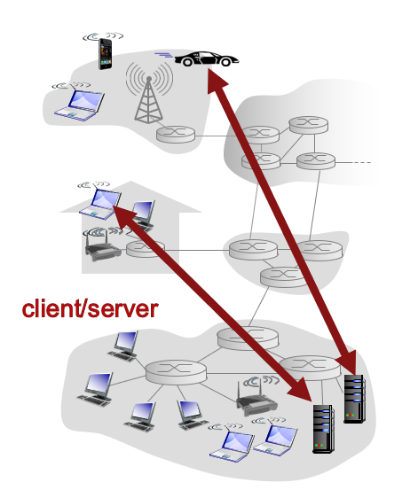
Client-Server Architecture
server:
always-on host
permanent I P address
data centers for scaling
clients:
communicate with server
may be intermittently connected
may have dynamic I P addresses
do not communicate directly with each other

Slide 8
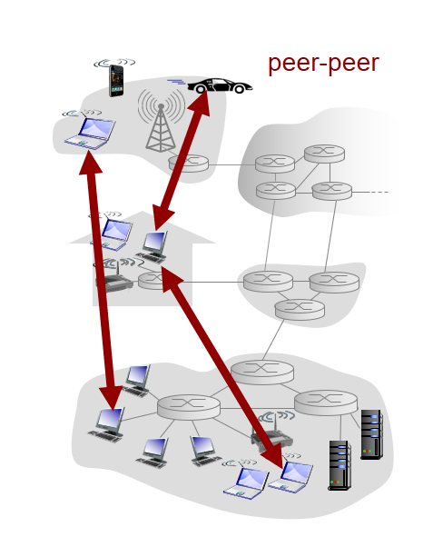
P2P Architecture
no always-on server
arbitrary end systems directly communicate
peers request service from other peers, provide service in return to other peers
self scalability – new peers bring new service capacity, as well as new service demands
peers are intermittently connected and change I P addresses
complex management

Slide 9
Processes Communicating
process: program running within a host
within same host, two processes communicate using inter-process communication (defined by O S)
processes in different hosts communicate by exchanging messages
clients, servers
client process: process that initiates communication
server process: process that waits to be contacted
aside: applications with P2P architectures have client processes & server processes

Slide 10
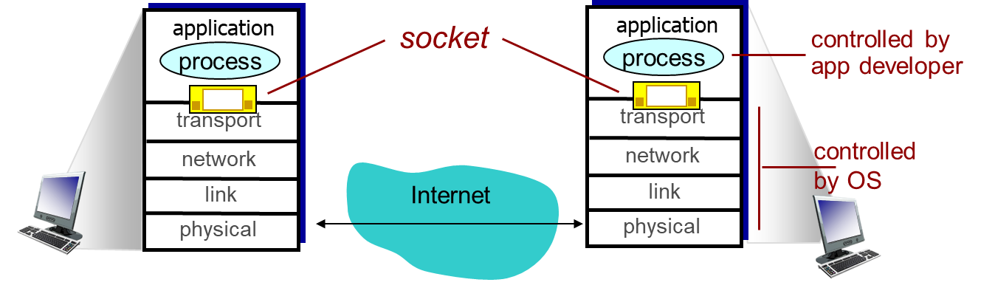
Sockets
process sends/receives messages to/from its socket
socket analogous to door
sending process shoves message out door
sending process relies on transport infrastructure on other side of door to deliver message to socket at receiving process

Slide 11
Addressing Processes
to receive messages, process must have identifier
host device has unique 32-bit I P address
Q: does I P address of host on which process runs suffice for identifying the process?
A: no, many processes can be running on same host
identifier includes both I P address and port numbers associated with process on host.
example port numbers:
H T T P server: 80
mail server: 25
to send H T T P message to gaia.cs.umass.edu web server:
I P address: 128.119.245.12
port number: 80
more shortly…

Slide 12
App-layer protocol defines
types of messages exchanged,
e.g., request, response
message syntax:
what fields in messages & how fields are delineated
message semantics
meaning of information in fields
rules for when and how processes send & respond to messages
open protocols:
defined in R F C s
allows for interoperability
e.g., H T T P, S M T P
proprietary protocols:
e.g., Skype

Slide 13
What Transport Service Does An App Need?
data integrity
some apps (e.g., file transfer, web transactions) require 100% reliable data transfer
other apps (e.g., audio) can tolerate some loss
throughput
some apps (e.g., multimedia) require minimum amount of throughput to be “effective”
other apps (“elastic apps”) make use of whatever throughput they get
timing
some apps (e.g., Internet telephony, interactive games) require low delay to be “effective”
security
encryption, data integrity, …

Slide 14
Transport Service Requirements: Common Apps
Application | Data Loss | Throughput | Time-Sensitive
file transfer | no loss | elastic | no
e-mail | no loss | elastic | no
Web documents | no loss | elastic | no
real-time audio/video | loss-tolerant | audio: 5kbps-1Mbps video:10kbps-5Mbps | yes, 100’s msec
stored audio/video | loss-tolerant | same as above | yes, few secs
interactive games | loss-tolerant | few kbps up | yes, 100’s msec
text messaging | no loss | elastic | yes and no

Slide 15
Internet Transport Protocols Services
T C P service:
reliable transport between sending and receiving process
flow control: sender won’t overwhelm receiver
congestion control: throttle sender when network overloaded
does not provide: timing, minimum throughput guarantee, security
connection-oriented: setup required between client and server processes
U D P service:
unreliable data transfer between sending and receiving process
does not provide: reliability, flow control, congestion control, timing, throughput guarantee, security, or connection setup,
Q: why bother? Why is there a U D P?

Slide 16
Internet Apps: Application, Transport Protocols
Application | Application layer protocol | Underlying transport protocol
e-mail | S M T P [R F C 2821] | T C P
remote terminal access | Telnet [R F C 854] | T C P
Web | H T T P [R F C 2616] | T C P
file transfer | F T P [R F C 959] | T C P
streaming multimedia | H T T P (e.g., YouTube), R T P [R F C 1889] | T C P or U D P
Internet telephony | S I P, R T P, proprietary (e.g., Skype) | T C P or U D P

Slide 17
Securing T C P
T C P & U D P
no encryption
cleartext passwds sent into socket traverse Internet in cleartext
S S L is at app layer
apps use S S L libraries, that “talk” to T C P
S S L socket A P I
cleartext passwords sent into socket traverse Internet encrypted
see Chapter 8
S S L
provides encrypted T C P connection
data integrity
end-point authentication

Slide 18
Learning Objectives (2 of 7)
2.1 Principles of network applications
2.2 Web and H T T P
2.3 electronic mail
S M T P, P O P3, I M A P
2.4 D N S
2.5 P 2 P applications
2.6 video streaming and content distribution networks
2.7 socket programming with U D P and T C P
Notes:
<number>

Slide 19
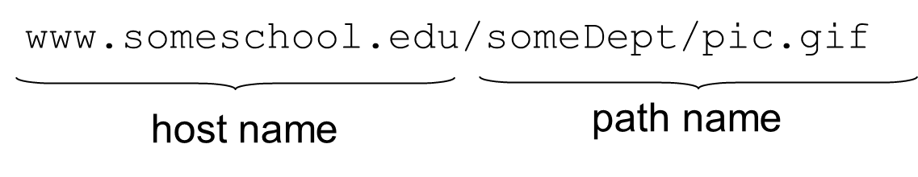
Web and H T T P
First, a review…
web page consists of objects
object can be H T M L file, J P E G image, Java applet, audio file,…
web page consists of base H T M L - file which includes several referenced objects
each object is addressable by a U R L, e.g.,

Slide 20
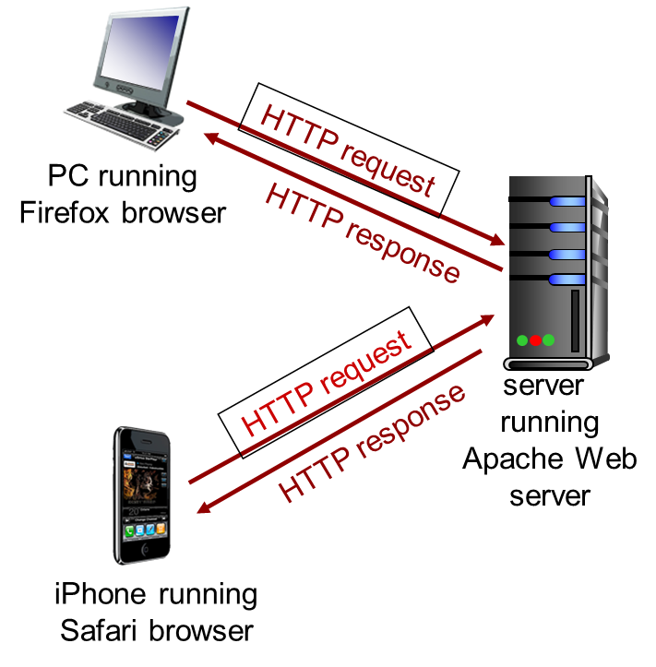
H T T P Overview (1 of 2)
H T T P: hypertext transfer protocol
Web’s application layer protocol
client/server model
client: browser that requests, receives, (using H T T P protocol) and “displays” Web objects
server: Web server sends (using H T T P protocol) objects in response to requests

Slide 21
H T T P Overview (2 of 2)
uses T C P:
client initiates T C P connection (creates socket) to server, port 80
server accepts T C P connection from client
H T T P messages (application-layer protocol messages) exchanged between browser (H T T P client) and Web server (H T T P server)
T C P connection closed
H T T P is “stateless”
server maintains no information about past client requests
aside
protocols that maintain “state” are complex!
past history (state) must be maintained
if server/client crashes, their views of “state” may be inconsistent, must be reconciled

Slide 22
H T T P Connections
non-persistent H T T P
at most one object sent over T C P connection
connection then closed
downloading multiple objects required multiple connections
persistent H T T P
multiple objects can be sent over single T C P connection between client, server

Slide 23
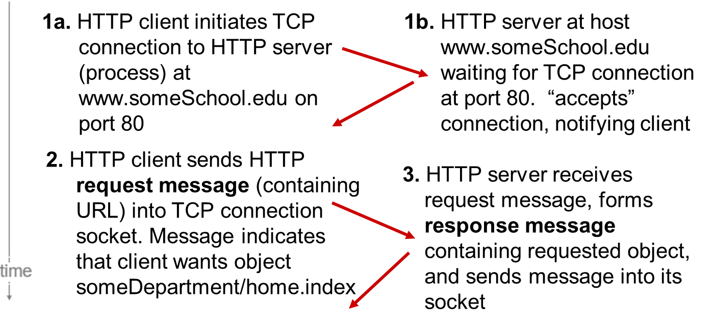
Non-Persistent H T T P (1 of 2)
suppose user enters U R L:
www.someSchool.edu/someDepartment/home.index

Slide 24
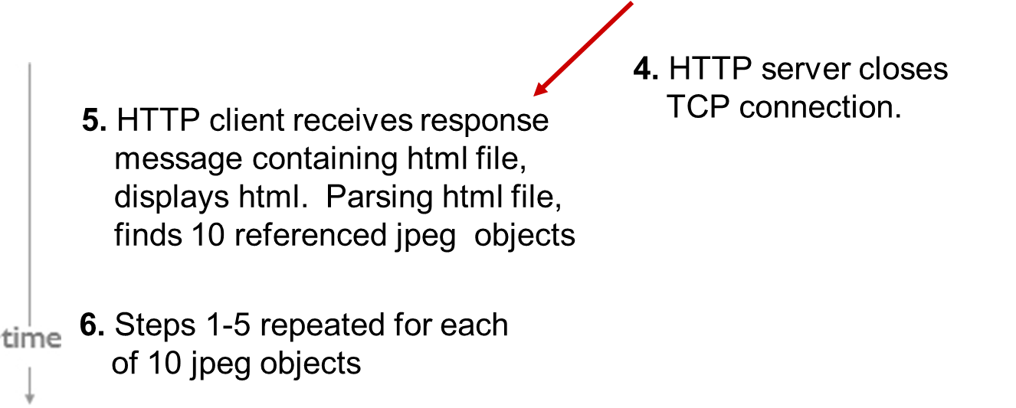
Non-Persistent H T T P (2 of 2)

Slide 25
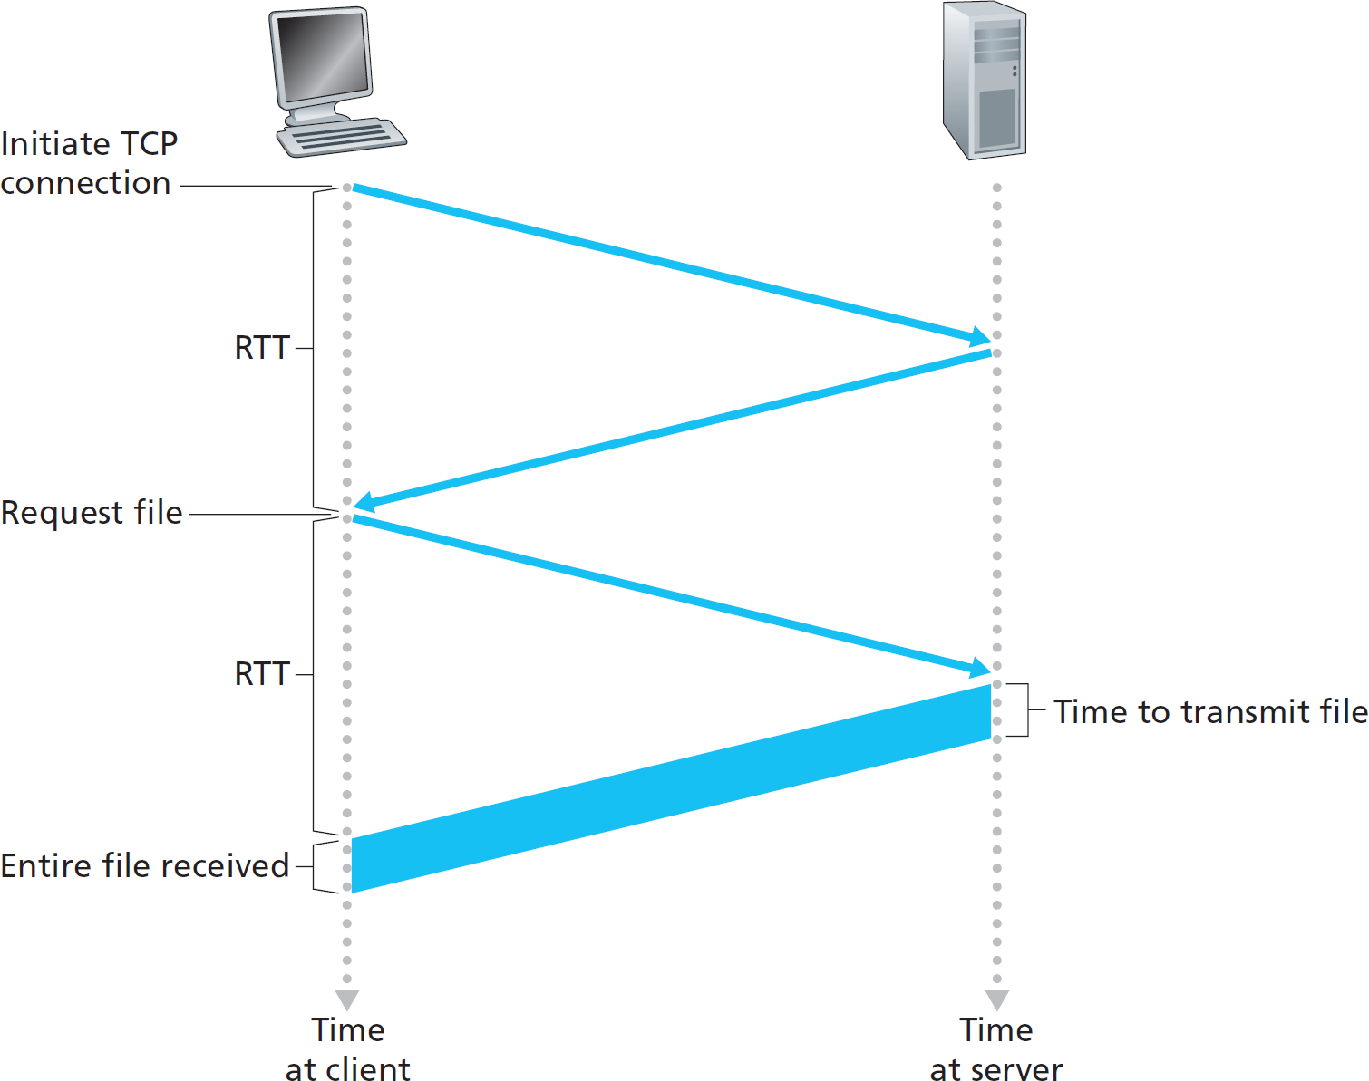
Non-Persistent H T T P: Response Time
R T T (definition): time for a small packet to travel from client to server and back
H T T P response time:
one R T T to initiate T C P connection
one R T T for H T T P request and first few bytes of H T T P response to return
file transmission time
non-persistent H T T P response time = 2R T T+ file transmission time

Slide 26
Persistent H T T P
non-persistent H T T P issues:
requires 2 R T T s per object
O S overhead for each T C P connection
browsers often open parallel T C P connections to fetch referenced objects
persistent H T T P:
server leaves connection open after sending response
subsequent H T T P messages between same client/server sent over open connection
client sends requests as soon as it encounters a referenced object
as little as one R T T for all the referenced objects

Slide 27
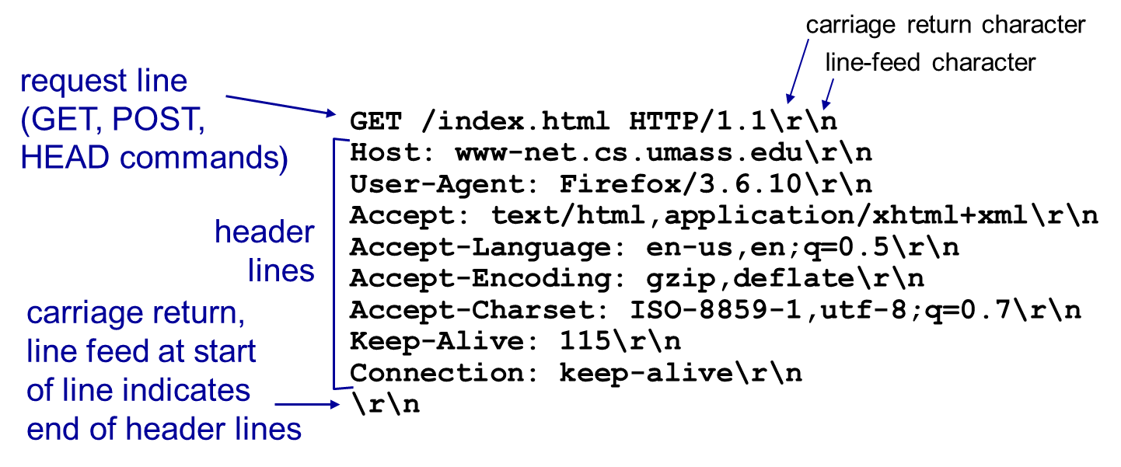
H T T P Request Message
two types of H T T P messages: request, response
H T T P request message:
A S C I I (human-readable format)
* Check out the online interactive exercises for more examples: http://gaia.cs.umass.edu/kurose_ross/interactive/

Slide 28
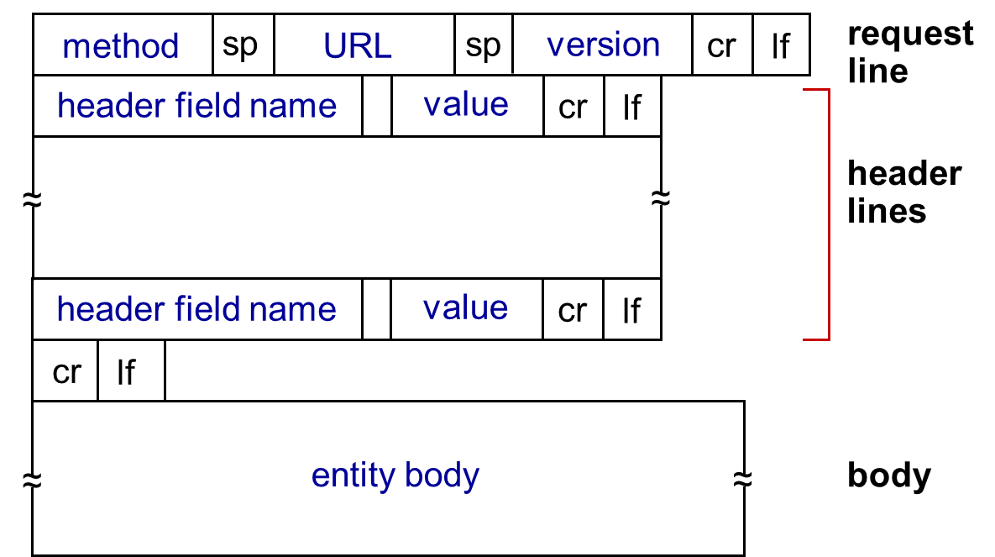
H T T P Request Message: General Format

Slide 29
Uploading Form Input
POST method:
web page often includes form input
input is uploaded to server in entity body
U R L method:
uses GET method
input is uploaded in U R L field of request line:
www.somesite.com/animalsearch?monkeys&banana

Slide 30
Method Types
H T T P/1.0:
GET
POST
HEAD
asks server to leave requested object out of response
H T T P/1.1:
GET, POST, HEAD
PUT
uploads file in entity body to path specified in U R L field
DELETE
deletes file specified in the U R L field

Slide 31
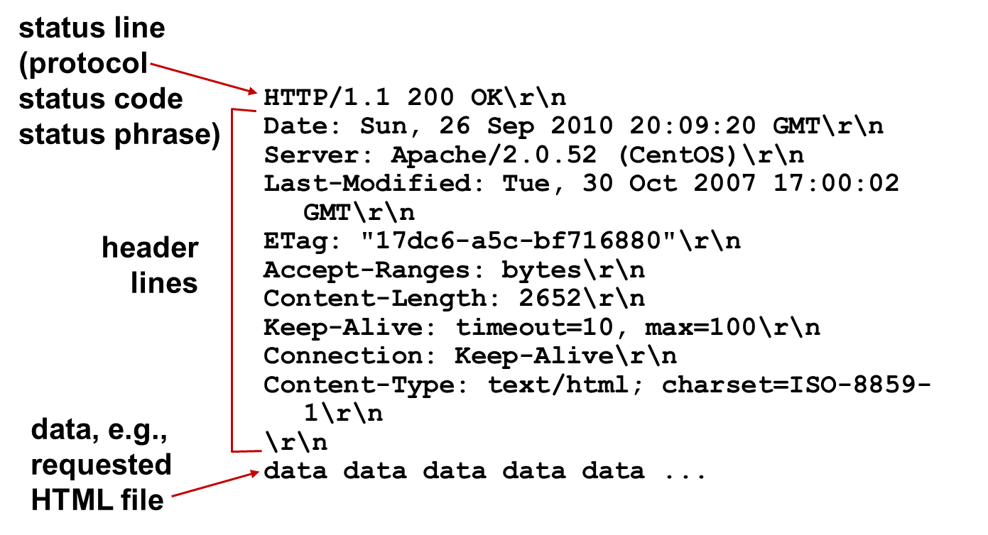
H T T P Response Message
* Check out the online interactive exercises for more examples: http://gaia.cs.umass.edu/kurose_ross/interactive/

Slide 32
H T T P Response Status Codes
status code appears in 1st line in server-to-client response message.
some sample codes:
200 OK
request succeeded, requested object later in this msg
301 Moved Permanently
requested object moved, new location specified later in this msg (Location:)
400 Bad Request
request msg not understood by server
404 Not Found
requested document not found on this server
505 HTTP Version Not Supported

Slide 33
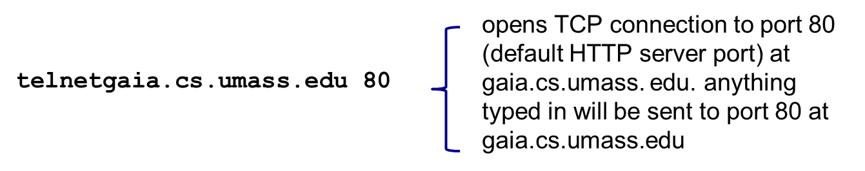
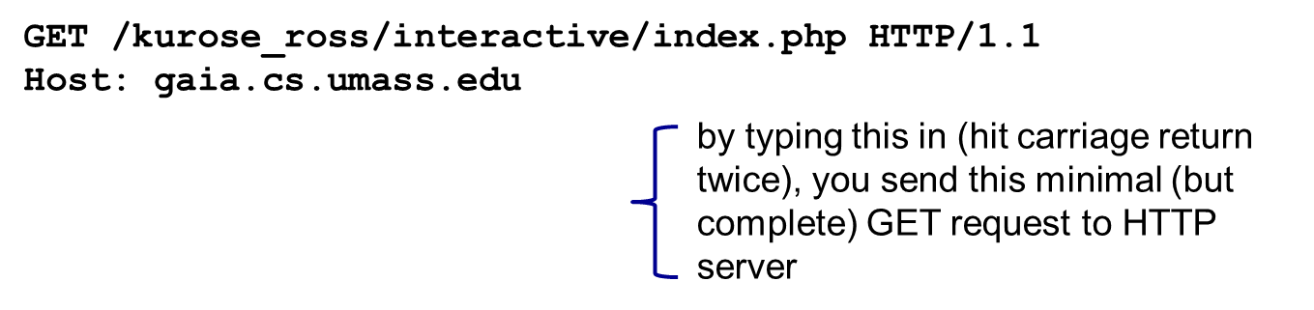
Trying out H T T P (Client Side) for Yourself
1. Telnet to your favorite Web server:
2. type in a GET H T T P request:
3. look at response message sent by H T T P server!
(or use Wireshark to look at captured H T T P request/response)

Slide 34
User-Server State: Cookies
example:
Susan always access Internet from P C
visits specific e-commerce site for first time
when initial H T T P requests arrives at site, site creates:
unique I D
entry in backend database for I D
many Web sites use cookies
four components:
1) cookie header line of H T T P response message
2) cookie header line in next H T T P request message
3) cookie file kept on user’s host, managed by user’s browser
4) back-end database at Web site

Slide 35
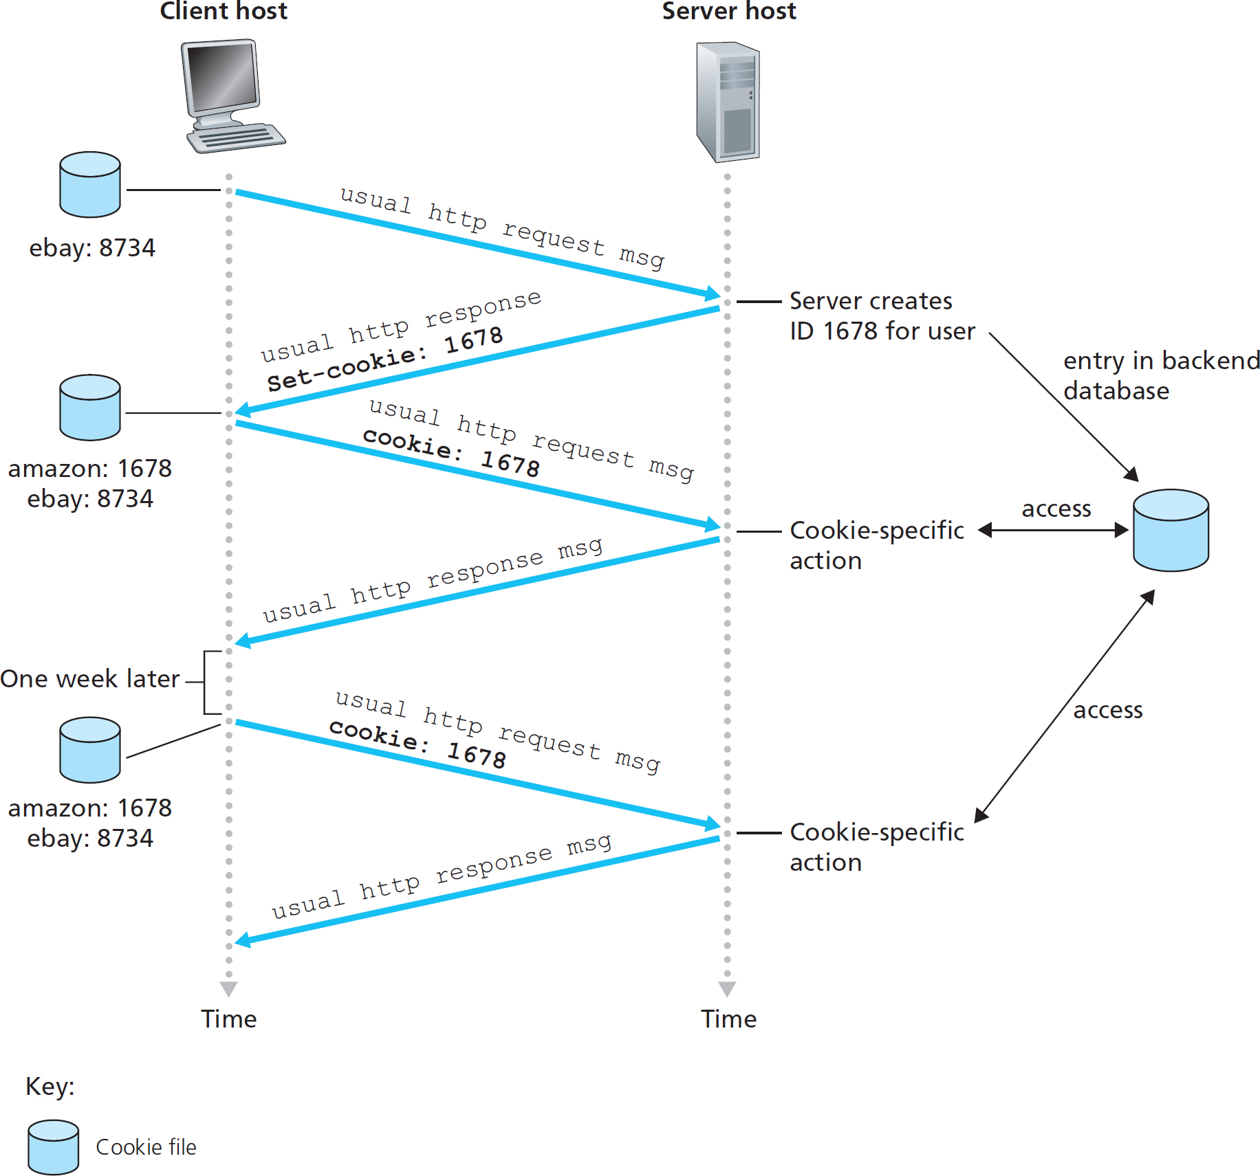
Cookies: keeping “state”

Slide 36
Cookies
what cookies can be used for:
authorization
shopping carts
recommendations
user session state (Web e-mail)
aside
cookies and privacy:
cookies permit sites to learn a lot about you
you may supply name and e-mail to sites
how to keep “state”:
protocol endpoints: maintain state at sender/receiver over multiple transactions
cookies: http messages carry state

Slide 37
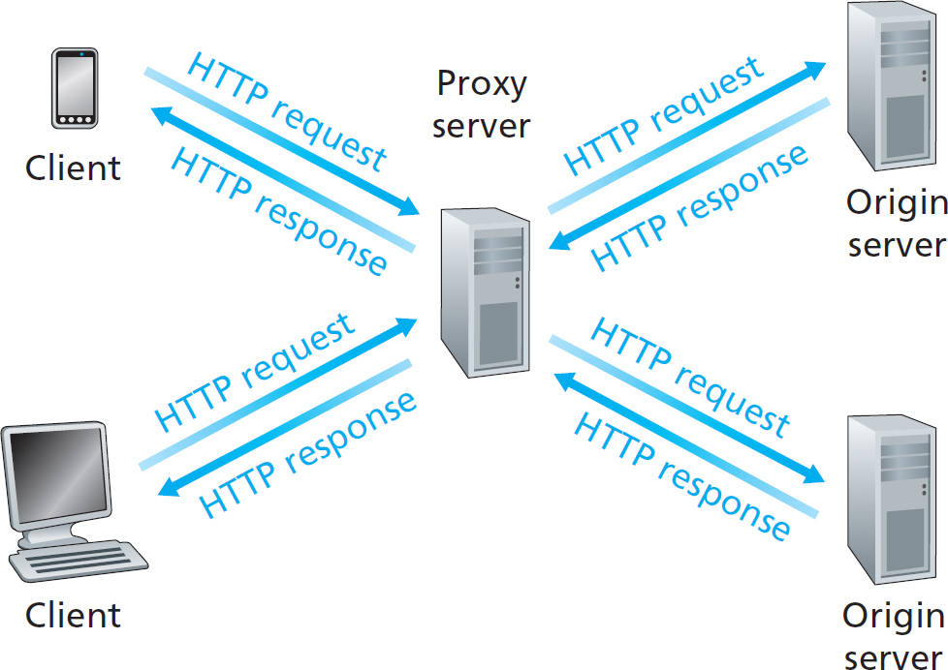
Web Caches (Proxy Server)
goal: satisfy client request without involving origin server
user sets browser: Web accesses via cache
browser sends all H T T P requests to cache
object in cache: cache returns object
else cache requests object from origin server, then returns object to client

Slide 38
More About Web Caching
cache acts as both client and server
server for original requesting client
client to origin server
typically cache is installed by I S P (university, company, residential I S P)
why Web caching?
reduce response time for client request
reduce traffic on an institution’s access link
Internet dense with caches: enables “poor” content providers to effectively deliver content (so too does P2P file sharing)

Slide 39
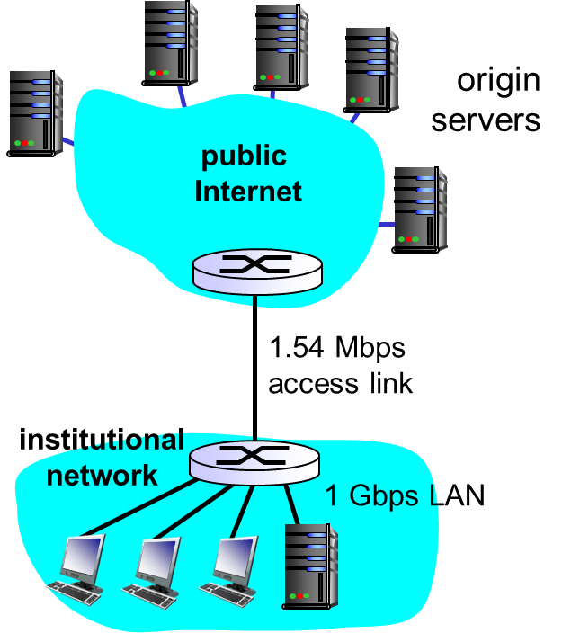
Caching Example: (1 of 2)
assumptions:
avg object size: 100K bits
avg request rate from browsers to origin servers:15/sec
avg data rate to browsers: 1.50 M b p s
R T T from institutional router to any origin server: 2 sec
access link rate: 1.54 M b p s

Slide 40
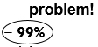
Caching Example: (2 of 2)
consequences:
L A N utilization: 15%
access link utilization
total delay = Internet delay + access delay + L A N delay
= 2 sec + minutes + usecs

Slide 41
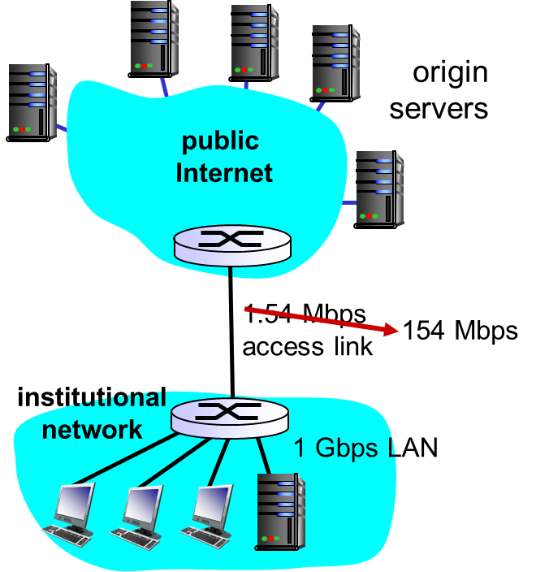
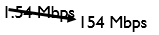
Caching Example: Fatter Access Link (1 of 2)
assumptions:
avg object size: 100K bits
avg request rate from browsers to origin servers:15/sec
avg data rate to browsers: 1.50 M b p s
R T T from institutional router to any origin server: 2 sec
access link rate:

Slide 42
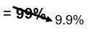
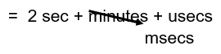
Caching Example: Fatter Access Link (2 of 2)
consequences:
L A N utilization: 15%
access link utilization
total delay = Internet delay + access delay + L A N delay
Cost: increased access link speed (not cheap!)

Slide 43
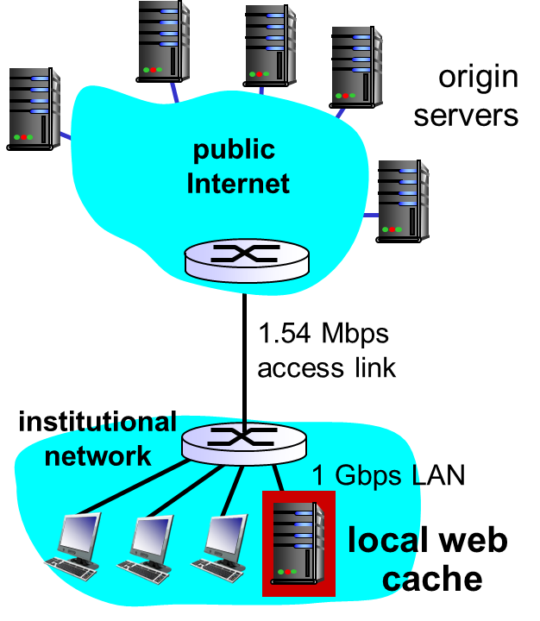
Caching Example: Install Local Cache (1 of 3)
assumptions:
avg object size: 100K bits
avg request rate from browsers to origin servers:15/sec
avg data rate to browsers: 1.50 M b p s
RTT from institutional router to any origin server: 2 sec
access link rate: 1.54 Mbps

Slide 44
Caching Example: Install Local Cache (2 of 3)
consequences:
LAN utilization: 15%
access link utilization = 100?
total delay = Internet delay + access delay + LAN delay 2 sec + minutes + usecs
How to compute link utilization, delay?
Cost: web cache (cheap!)

Slide 45
Caching Example: Install Local Cache (3 of 3)
Calculating access link utilization, delay with cache:
suppose cache hit rate is 0.4
40% requests satisfied at cache, 60% requests satisfied at origin
access link utilization:
60% of requests use access link
data rate to browsers over access link
utilization
total delay
less than with 154 M b p s link (and cheaper too!)

Slide 46
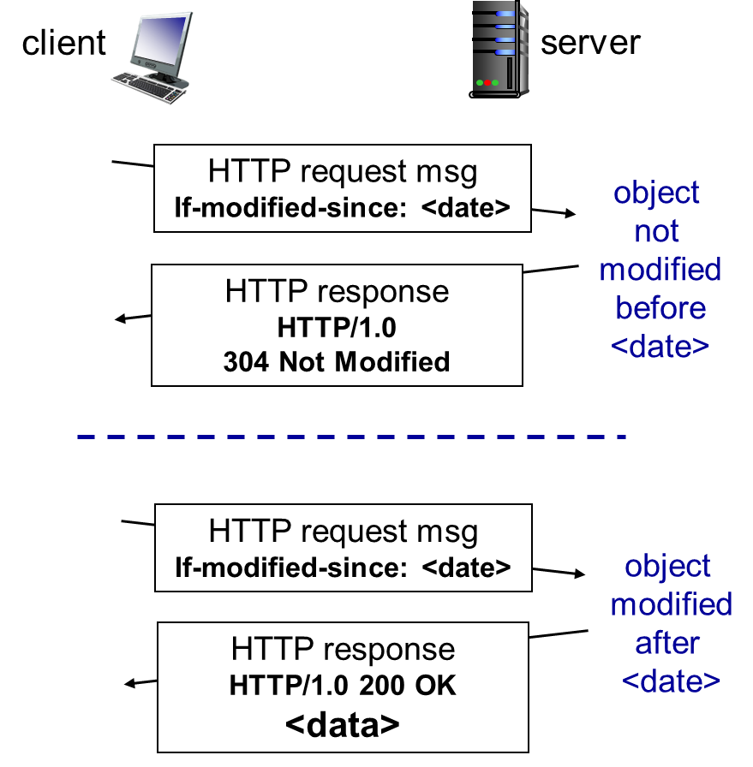
Conditional GET
Goal: don’t send object if cache has up-to-date cached version
no object transmission delay
lower link utilization
cache: specify date of cached copy in H T T P request
If-modified-since: <date>
server: response contains no object if cached copy is up-to-date:
H T T P/1.0 304 Not Modified

Slide 47
Learning Objectives (3 of 7)
2.1 Principles of network applications
2.2 Web and H T T P
2.3 electronic mail
S M T P, P O P3, I M A P
2.4 D N S
2.5 P 2 P applications
2.6 video streaming and content distribution networks
2.7 socket programming with U D P and T C P

Slide 48
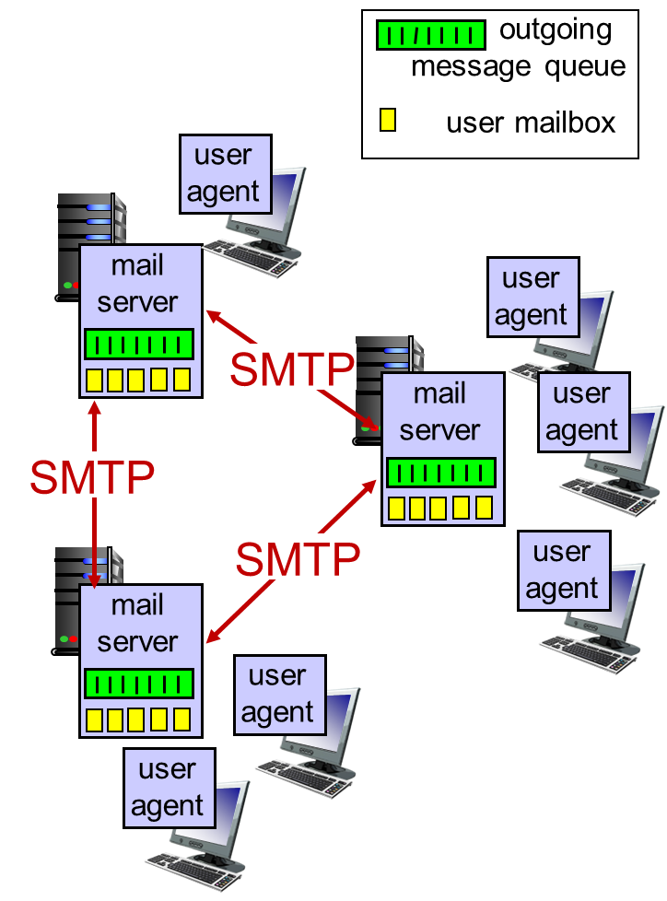
Electronic Mail
Three major components:
user agents
mail servers
simple mail transfer protocol: S M T P
User Agent
a.k.a. “mail reader”
composing, editing, reading mail messages
e.g., Outlook, Thunderbird, iPhone mail client
outgoing, incoming messages stored on server

Slide 49
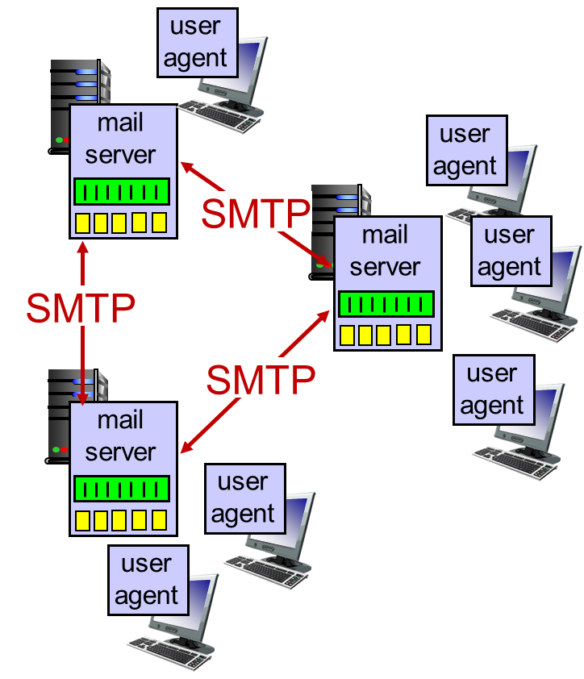
Electronic Mail: Mail Servers
mail servers:
mailbox contains incoming messages for user
message queue of outgoing (to be sent) mail messages
S M T P protocol between mail servers to send email messages
client: sending mail server
“server”: receiving mail server

Slide 50
Electronic Mail: S M T P [R F C 2821]
uses T C P to reliably transfer email message from client to server, port 25
direct transfer: sending server to receiving server
three phases of transfer
handshaking (greeting)
transfer of messages
closure
command/response interaction (like H T T P)
commands: A S C I I text
response: status code and phrase
messages must be in 7-bit A S C I

Slide 51
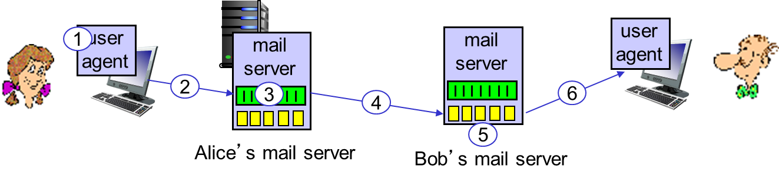
Scenario: Alice Sends Message to Bob
1) Alice uses U A to compose message “to” bob@someschool.edu
2) Alice’s U A sends message to her mail server; message placed in message queue
3) client side of S M T P opens T C P connection with Bob’s mail server
4) S M T P client sends Alice’s message over the T C P connection
5) Bob’s mail server places the message in Bob’s mailbox
6) Bob invokes his user agent to read message

Slide 52
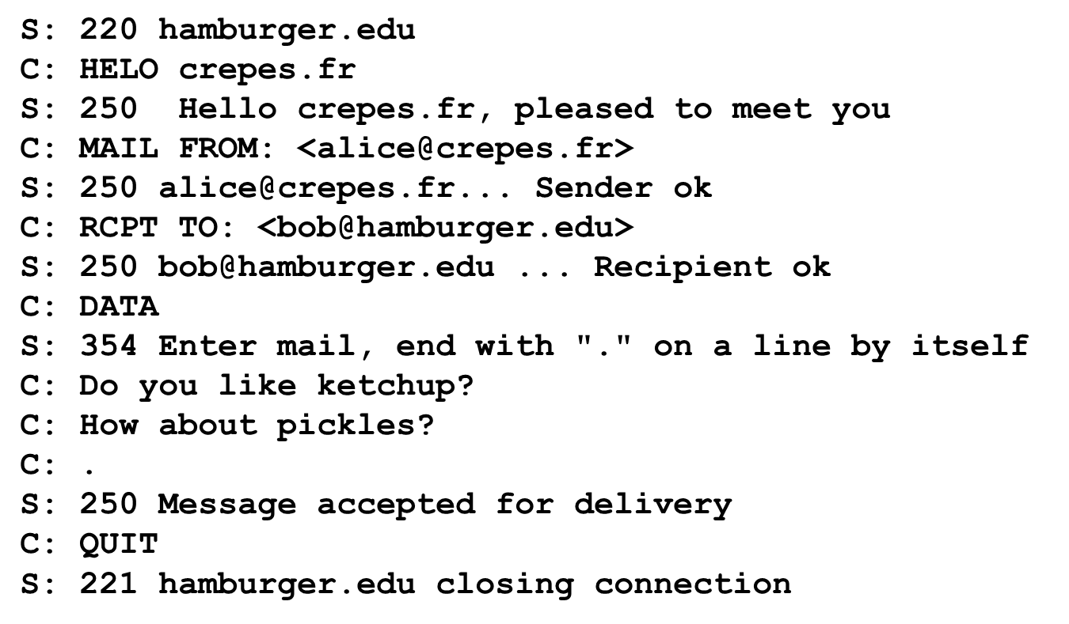
Sample S M T P Interaction

Slide 53
Try S M T P Interaction for Yourself
telnet servername 25
see 220 reply from server
enter HELO, MAIL FROM, RCPT TO, DATA, QUIT commands
above lets you send email without using email client (reader)

Slide 54
S M T P: Final Words
S M T P uses persistent connections
S M T P requires message (header & body) to be in 7-bit A S C I I
S M T P server uses CRLF.CRLF to determine end of message
comparison with H T T P:
H T T P: pull
S M T P: push
both have A S C I I command/response interaction, status codes
H T T P: each object encapsulated in its own response message
S M T P: multiple objects sent in multipart message

Slide 55
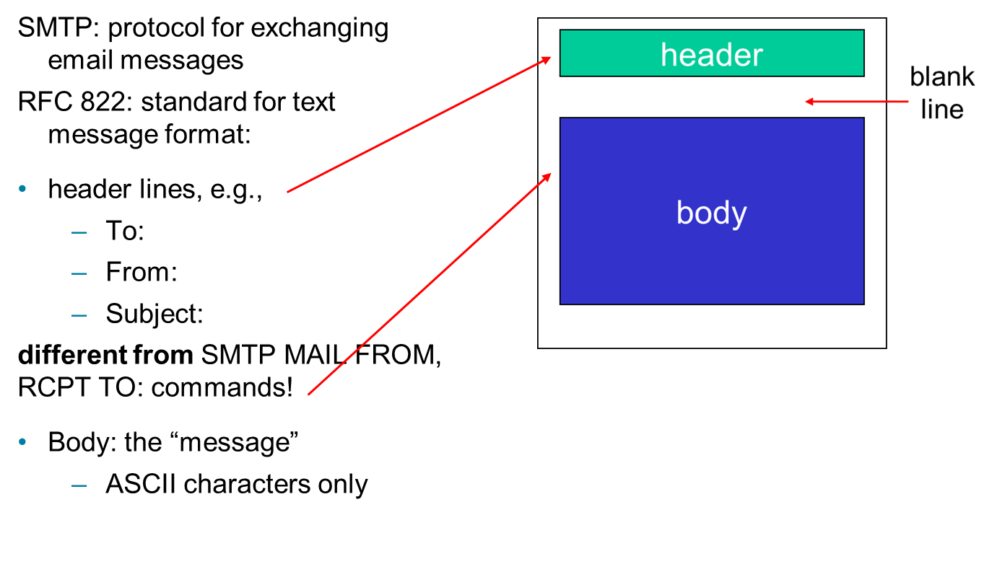
Mail Message Format
Notes:
<number>

Slide 56
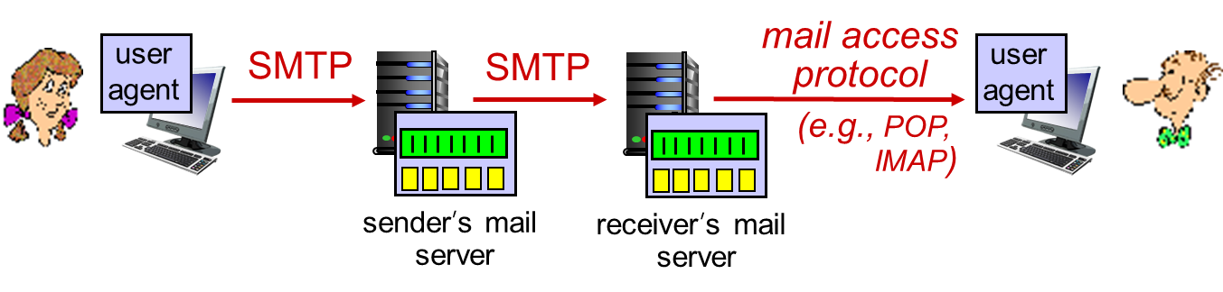
Mail Access Protocols
S M T P: delivery/storage to receiver’s server
mail access protocol: retrieval from server
P O P: Post Office Protocol [R F C 1939]: authorization, download
I M A P: Internet Mail Access Protocol [R F C 1730]: more features, including manipulation of stored messages on server
H T T P: gmail, Hotmail, Yahoo! Mail, etc.

Slide 57
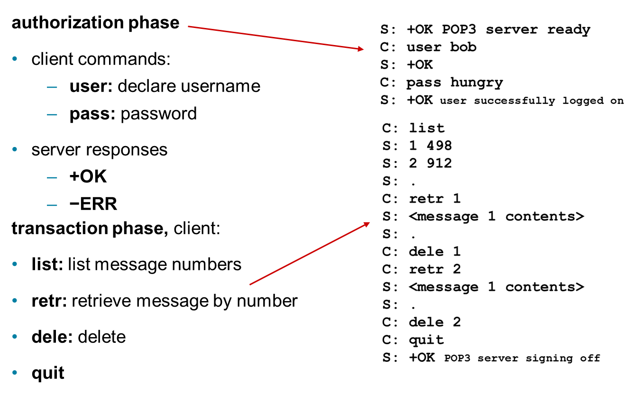
P O P3 Protocol

Slide 58
P O P3 (More) and I M A P
more about P O P3
previous example uses P O P3 “download and delete” mode
Bob cannot re-read e-mail if he changes client
P O P3 “download-and-keep”: copies of messages on different clients
P O P3 is stateless across sessions
I M A P
keeps all messages in one place: at server
allows user to organize messages in folders
keeps user state across sessions:
names of folders and mappings between message I D s and folder name

Slide 59
Learning Objectives (4 of 7)
2.1 Principles of network applications
2.2 Web and H T T P
2.3 electronic mail
S M T P, P O P3, I M A P
2.4 D N S
2.5 P 2 P applications
2.6 video streaming and content distribution networks
2.7 socket programming with U D P and T C P

Slide 60
D N S: Domain Name System
people: many identifiers:
S S N, name, passport #
Domain Name System:
distributed database implemented in hierarchy of many name servers
application-layer protocol: hosts, name servers communicate to resolve names (address/name translation)
note: core Internet function, implemented as application-layer protocol
complexity at network’s “edge”
Internet hosts, routers:
I P address (32 bit) - used for addressing datagrams
“name”, e.g., www.yahoo.com - used by humans
Q: how to map between I P address and name, and vice versa?

Slide 61
D N S: Services, Structure
D N S services
hostname to I P address translation
host aliasing
canonical, alias names
mail server aliasing
load distribution
replicated Web servers: many I P addresses correspond to one name
why not centralize D N S?
single point of failure
traffic volume
distant centralized database
maintenance
A: doesn‘t scale!

Slide 62
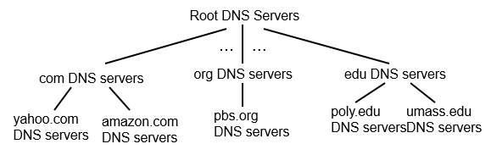
D N S: A Distributed, Hierarchical Database
client wants I P for www.amazon.com;
approximation:
client queries root server to find com D N S server
client queries .com D N S server to get amazon.com D N S server
client queries amazon.com D N S server to get I P address for www.amazon.com

Slide 63
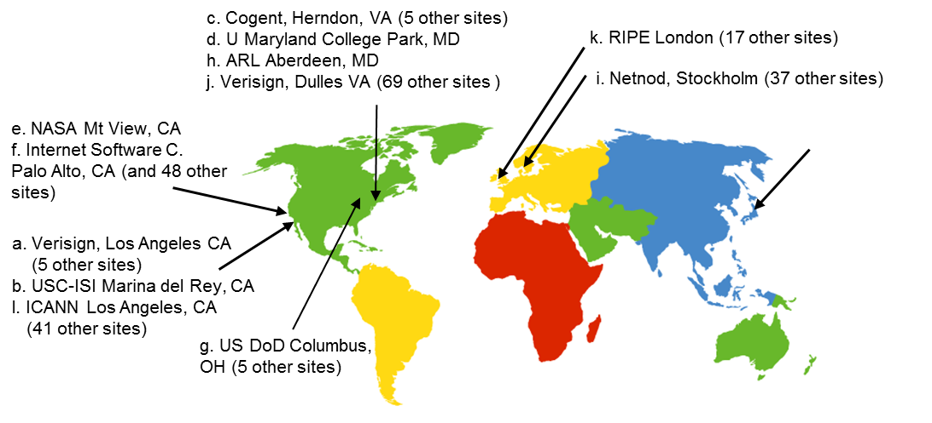
D N S: Root Name Servers
contacted by local name server that can not resolve name
root name server:
contacts authoritative name server if name mapping not known
gets mapping
returns mapping to local name server
13 logical root name “servers” worldwide
each “server” replicated many times

Slide 64
T L D, Authoritative Servers
top-level domain (T L D) servers:
responsible for com, org, net, edu, aero, jobs, museums, and all top-level country domains, e.g.: uk, fr, ca, jp
Network Solutions maintains servers for .com T L D
Educause for .edu T L D
authoritative D N S servers:
Organization’s own D N S server(s), providing authoritative hostname to I P mappings for organization’s named hosts
can be maintained by organization or service provider

Slide 65
Local D N S Name Server
does not strictly belong to hierarchy
each I S P (residential I S P, company, university) has one
also called “default name server”
when host makes D N S query, query is sent to its local D N S server
has local cache of recent name-to-address translation pairs (but may be out of date!)
acts as proxy, forwards query into hierarchy

Slide 66
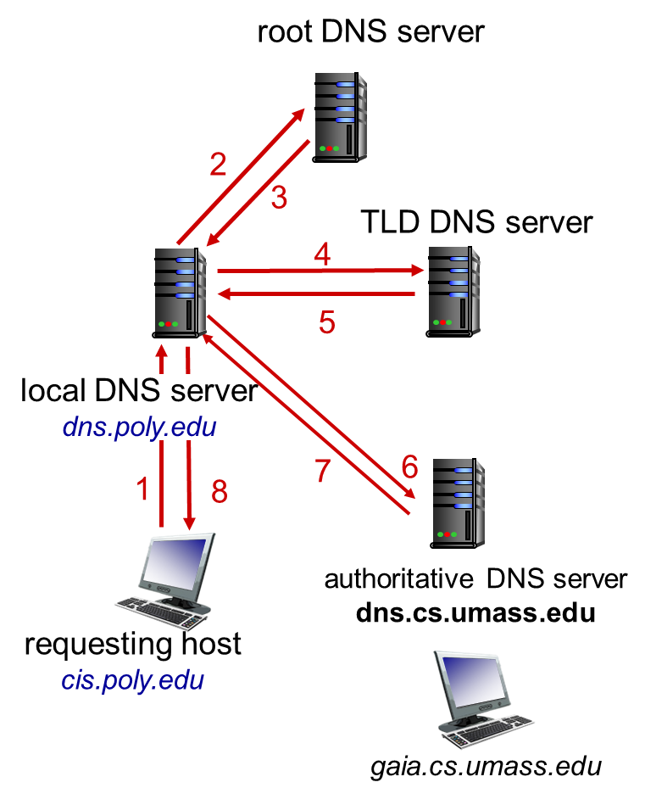
D N S Name Resolution Example (1 of 2)
host at cis.poly.edu wants I P address for gaia.cs.umass.edu
iterated query:
contacted server replies with name of server to contact
“I don’t know this name, but ask this server”

Slide 67
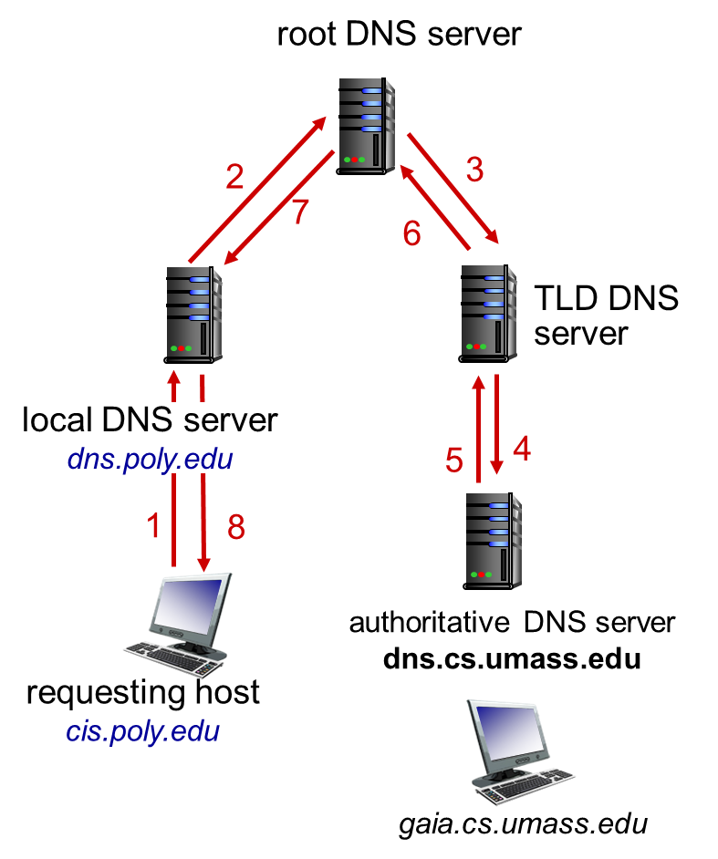
D N S Name Resolution Example (2 of 2)
recursive query:
puts burden of name resolution on contacted name server
heavy load at upper levels of hierarchy?

Slide 68
D N S: Caching, Updating Records
once (any) name server learns mapping, it caches mapping
cache entries timeout (disappear) after some time (T T L)
T L D servers typically cached in local name servers
thus root name servers not often visited
cached entries may be out-of-date (best effort name-to-address translation!)
if name host changes I P address, may not be known Internet-wide until all T T L s expire
update/notify mechanisms proposed I E T F standard
R F C 2136

Slide 69
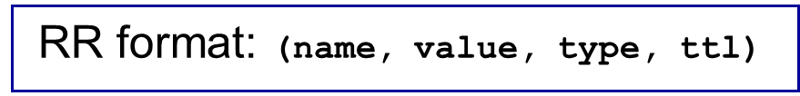
D N S Records
D N S: distributed database storing resource records (R R)
type=A
name is hostname
value is I P address
type=N S
name is domain (e.g., foo.com)
value is hostname of authoritative name server for this domain
type=CNAME
name is alias name for some “canonical” (the real) name
www.ibm.com is really servereast.backup2.ibm.com
value is canonical name
type=M X
value is name of mailserver associated with name

Slide 70
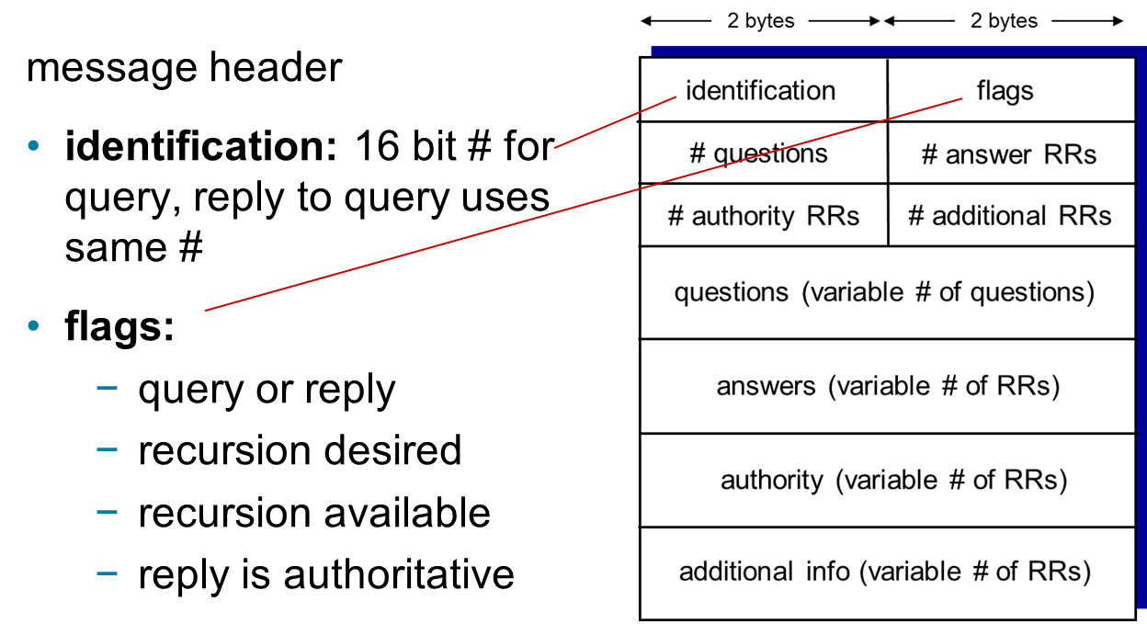
D N S Protocol, Messages (1 of 2)
query and reply messages, both with same message format

Slide 71
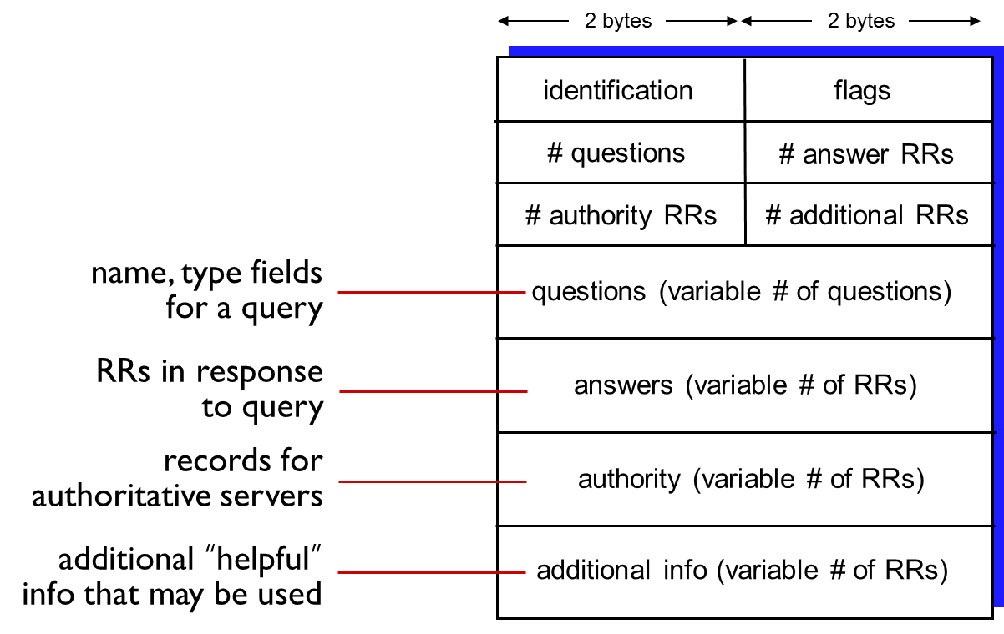
D N S Protocol, Messages (2 of 2)

Slide 72
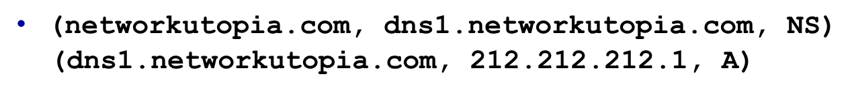
Inserting Records into D N S
example: new startup “Network Utopia”
register name networkuptopia.com at D N S registrar (e.g., Network Solutions)
provide names, I P addresses of authoritative name server (primary and secondary)
registrar inserts two R R s into.com T L D server:
create authoritative server type A record for www.networkuptopia.com; type M X record for networkutopia.com

Slide 73
Attacking D N S
D D o S attacks
bombard root servers with traffic
not successful to date
traffic filtering
local D N S servers cache I P s of T L D servers, allowing root server bypass
bombard T L D servers
potentially more dangerous
redirect attacks
man-in-middle
Intercept queries
D N S poisoning
Send bogus relies to D N S server, which caches
exploit D N S for D D o S
send queries with spoofed source address: target I P
requires amplification

Slide 74
Learning Objectives (5 of 7)
2.1 Principles of network applications
2.2 Web and H T T P
2.3 electronic mail
S M T P, P O P3, I M A P
2.4 D N S
2.5 P 2 P applications
2.6 video streaming and content distribution networks
2.7 socket programming with U D P and T C P

Slide 75
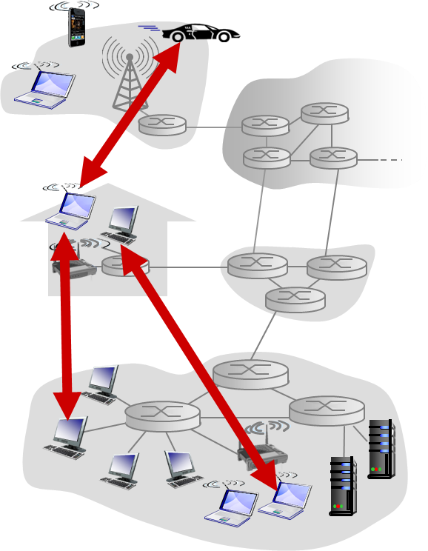
Pure P2P Architecture
no always-on server
arbitrary end systems directly communicate
peers are intermittently connected and change I P addresses
examples:
file distribution (BitTorrent)
Streaming (KanKan)
VoIP (Skype)

Slide 76
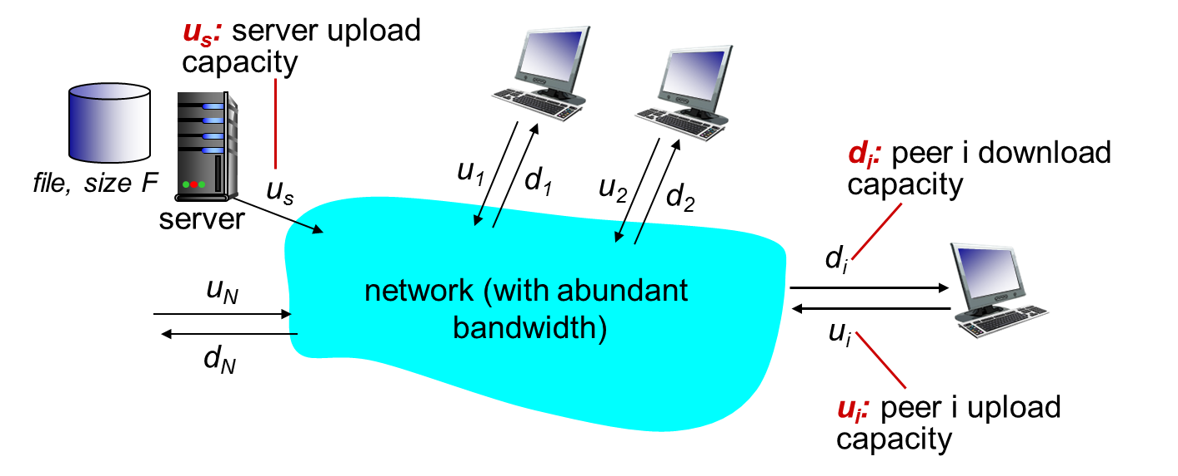
File Distribution: Client-Server versus P2P
Question: how much time to distribute file (size F) from one server to N peers?
peer upload/download capacity is limited resource

Slide 77
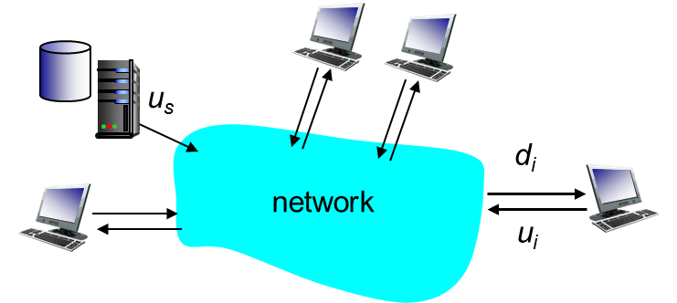
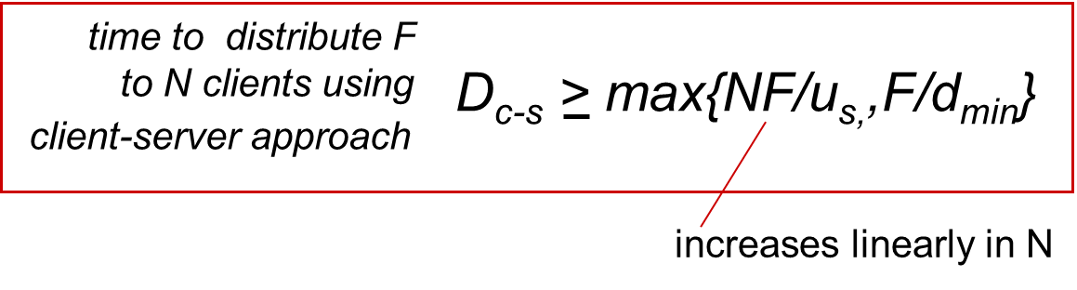
File Distribution Time: Client-Server
server transmission: must sequentially send (upload) N file copies:
time to send one copy:
time to send N copies:
client: each client must download file copy
d_{min} = min client download rate
min client download time:

Slide 78
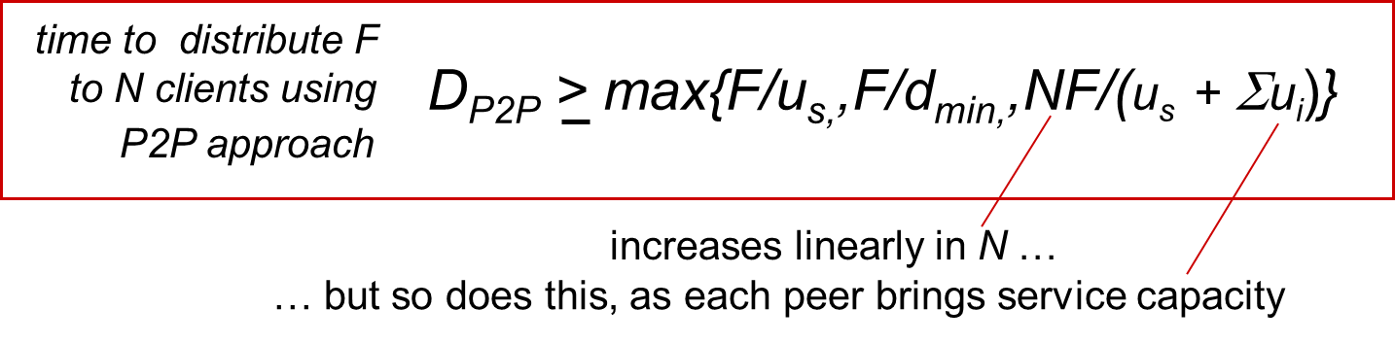
File Distribution Time: P2P
server transmission: must upload at least one copy
time to send one copy:
client: each client must download file copy
min client download time:
clients: as aggregate must download N F bits
max upload rate (limiting max download rate) is

Slide 79
Client-Server versus P2P: Example
client upload rate = u, F/u = 1 hour, u_{s} = 10u, d_{min} ≥ u_{s}

Slide 80
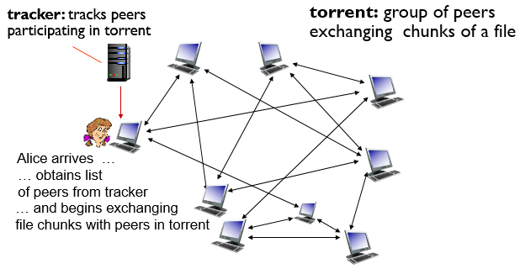
P2P File Distribution: BitTorrent (1 of 2)
file divided into 256Kilobytes chunks
peers in torrent send/receive file chunks

Slide 81
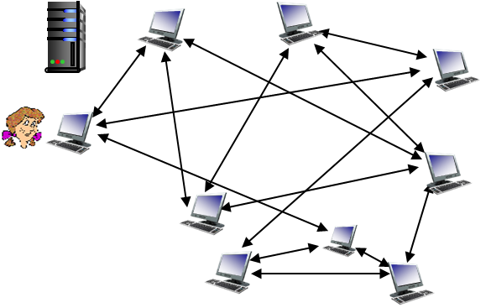
P2P File Distribution: BitTorrent (2 of 2)
peer joining torrent:
has no chunks, but will accumulate them over time from other peers
registers with tracker to get list of peers, connects to subset of peers (“neighbors”)
while downloading, peer uploads chunks to other peers
peer may change peers with whom it exchanges chunks
churn: peers may come and go
once peer has entire file, it may (selfishly) leave or (altruistically) remain in torrent

Slide 82
BitTorrent: Requesting, Sending File Chunks
requesting chunks:
at any given time, different peers have different subsets of file chunks
periodically, Alice asks each peer for list of chunks that they have
Alice requests missing chunks from peers, rarest first
sending chunks: tit-for-tat
Alice sends chunks to those four peers currently sending her chunks at highest rate
other peers are choked by Alice (do not receive chunks from her)
re-evaluate top 4 every10 secs
every 30 secs: randomly select another peer, starts sending chunks
“optimistically unchoke” this peer
newly chosen peer may join top 4

Slide 83
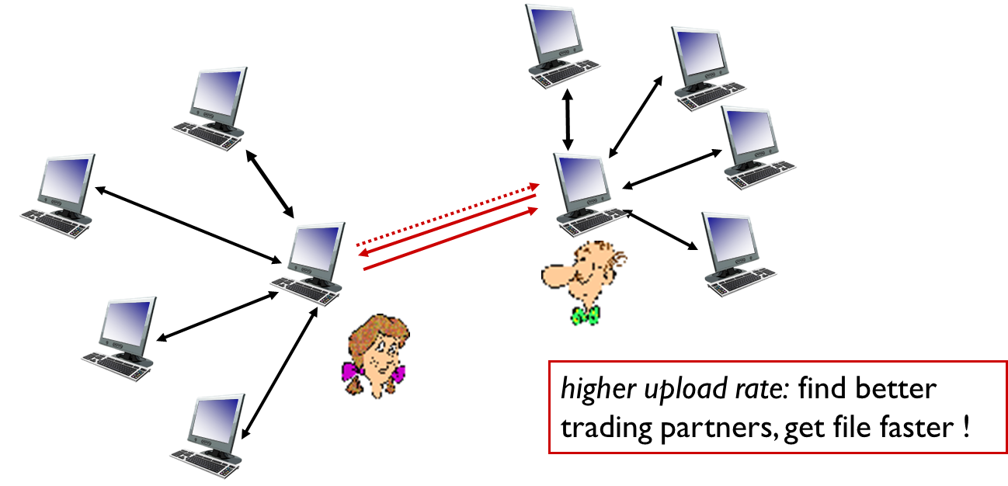
BitTorrent: Tit-For-Tat
(1) Alice “optimistically unchokes” Bob
(2) Alice becomes one of Bob’s top-four providers; Bob reciprocates
(3) Bob becomes one of Alice’s top-four providers

Slide 84
Learning Objectives (6 of 7)
2.1 Principles of network applications
2.2 Web and H T T P
2.3 electronic mail
S M T P, P O P3, I M A P
2.4 D N S
2.5 P 2 P applications
2.6 video streaming and content distribution networks (C D N s)
2.7 socket programming with U D P and T C P

Slide 85

Video Streaming and C D N s: Context
video traffic: major consumer of Internet bandwidth
Netflix, YouTube: 37%, 16% of downstream residential I S P traffic
~1B YouTube users, ~75M Netflix users
challenge: scale - how to reach ~1B users?
single mega-video server won’t work (why?)
challenge: heterogeneity
different users have different capabilities (e.g., wired versus mobile; bandwidth rich versus bandwidth poor)
solution: distributed, application-level infrastructure

Slide 86
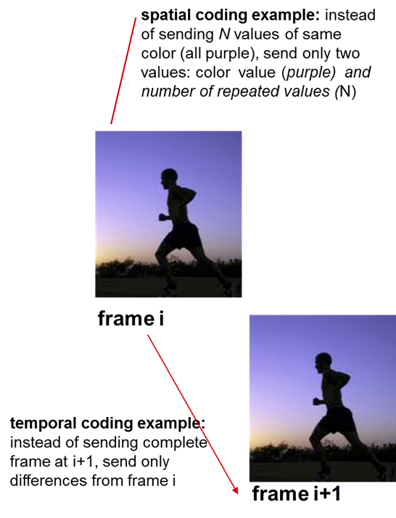
Multimedia: Video (1 of 2)
video: sequence of images displayed at constant rate
e.g., 24 images/sec
digital image: array of pixels
each pixel represented by bits
coding: use redundancy within and between images to decrease # bits used to encode image
spatial (within image)
temporal (from one image to next)

Slide 87
Multimedia: Video (2 of 2)
C B R: (constant bit rate): video encoding rate fixed
V B R: (variable bit rate): video encoding rate changes as amount of spatial, temporal coding changes
examples:
M P E G1 (C D-R O M) 1.5 M b p s
M P E G2 (D V D) 3-6 M b p s
M P E G4 (often used in Internet, < 1 M b p s)

Slide 88
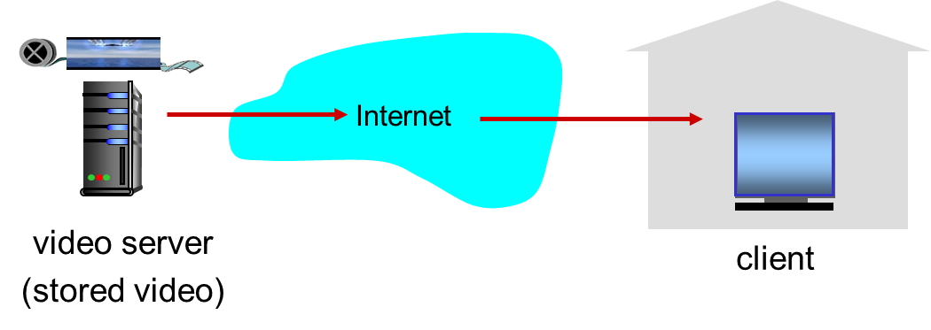
Streaming Stored Video
simple scenario:

Slide 89
Streaming Multimedia: D A S H (1 of 2)
D A S H: Dynamic, Adaptive Streaming over H T T P
server:
divides video file into multiple chunks
each chunk stored, encoded at different rates
manifest file: provides U R L s for different chunks
client:
periodically measures server-to-client bandwidth
consulting manifest, requests one chunk at a time
chooses maximum coding rate sustainable given current bandwidth
can choose different coding rates at different points in time (depending on available bandwidth at time)

Slide 90
Streaming Multimedia: D A S H (2 of 2)
“intelligence” at client: client determines
when to request chunk (so that buffer starvation, or overflow does not occur)
what encoding rate to request (higher quality when more bandwidth available)
where to request chunk (can request from U R L server that is “close” to client or has high available bandwidth)

Slide 91
Content Distribution Networks (1 of 2)
challenge: how to stream content (selected from millions of videos) to hundreds of thousands of simultaneous users?
option 1: single, large “mega-server”
single point of failure
point of network congestion
long path to distant clients
multiple copies of video sent over outgoing link
….quite simply: this solution doesn’t scale

Slide 92
Content Distribution Networks (2 of 2)
option 2: store/serve multiple copies of videos at multiple geographically distributed sites (C D N)
enter deep: push C D N servers deep into many access networks
close to users
used by Akamai, 1700 locations
bring home: smaller number (10’s) of larger clusters in P O Ps near (but not within) access networks
used by Limelight

Slide 93
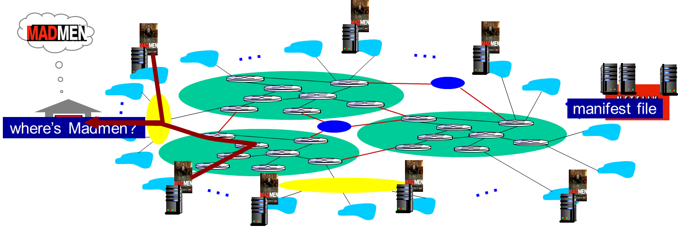
Content Distribution Networks (C D N s) (1 of 2)
C D N: stores copies of content at C D N nodes
e.g. Netflix stores copies of MadMen
subscriber requests content from C D N
directed to nearby copy, retrieves content
may choose different copy if network path congested
Notes:
Akamai: 100,000+ servers in 1000+ clusters in 1000+ networks in 70+ countries serving trillions of requests a day.
How many people use Netflix?
<number>

Slide 94

Content Distribution Networks (C D N s) (2 of 2)
O T T challenges: coping with a congested Internet
from which C D N node to retrieve content?
viewer behavior in presence of congestion?
what content to place in which C D N node?
Notes:
peak load: 7million viewers, 2 Tbytes via
<number>

Slide 95

C D N Content Access: A Closer Look
Bob (client) requests video http://netcinema.com/6Y7B23V
video stored in C D N at http://KingCDN.com/NetC6y&B23V
1. Bob gets U R L for video http://netcinema.com/6Y7B23V from netcinema.com web page
2. resolve http://netcinema.com/6Y7B23V via Bob’s local D N S
3. netcinema’s D N S returns U R L http://KingCDN.com/NetC6y&B23V
4&5. Resolve http://KingCDN.com/NetC6y&B23 via KingC D N’s authoritative D N S, which returns I P address of KingC D N server with video

Slide 96

Case Study: Netflix

Slide 97
Learning Objectives (7 of 7)
2.1 Principles of network applications
2.2 Web and H T T P
2.3 electronic mail
S M T P, P O P3, I M A P
2.4 D N S
2.5 P 2 P applications
2.6 video streaming and content distribution networks
2.7 socket programming with U D P and T C P

Slide 98

Socket Programming (1 of 2)
goal: learn how to build client/server applications that communicate using sockets
socket: door between application process and end-end-transport protocol

Slide 99
Socket Programming (2 of 2)
Two socket types for two transport services:
U D P: unreliable datagram
T C P: reliable, byte stream-oriented
Application Example:
client reads a line of characters (data) from its keyboard and sends data to server
server receives the data and converts characters to uppercase
server sends modified data to client
client receives modified data and displays line on its screen

Slide 100
Socket Programming with U D P
U D P: no “connection” between client & server
no handshaking before sending data
sender explicitly attaches I P destination address and port # to each packet
receiver extracts sender I P address and port# from received packet
U D P: transmitted data may be lost or received out-of-order
Application viewpoint:
U D P provides unreliable transfer of groups of bytes (“datagrams”) between client and server

Slide 101

Client/Server Socket Interaction: U D P

Slide 102

Example App: U D P Client

Slide 103

Example App: U D P Server

Slide 104
Socket Programming with T C P
client must contact server
server process must first be running
server must have created socket (door) that welcomes client’s contact
when contacted by client, server T C P creates new socket for server process to communicate with that particular client
allows server to talk with multiple clients
source port numbers used to distinguish clients (more in Chap 3)
client contacts server by:
Creating T C P socket, specifying I P address, port number of server process
when client creates socket: client T C P establishes connection to server T C P
application viewpoint:
T C P provides reliable, in-order byte-stream transfer (“pipe”) between client and server

Slide 105

Client/Server Socket Interaction: T C P

Slide 106

Example App: T C P Client

Slide 107

Example App: T C P Server

Slide 108
Chapter 2: Summary (1 of 2)
our study of network apps now complete!
application architectures
client-server
P2P
application service requirements:
reliability, bandwidth, delay
Internet transport service model
connection-oriented, reliable: T C P
unreliable, datagrams: U D P
specific protocols:
H T T P
S M T P, P O P, I M A P
D N S
P2P: BitTorrent
video streaming, C D N s
socket programming:
T C P, U D P sockets

Slide 109
Chapter 2: Summary (2 of 2)
most importantly: learned about protocols!
typical request/reply message exchange:
client requests info or service
server responds with data, status code
message formats:
headers: fields giving info about data
data: info(payload) being communicated
important themes:
control versus messages
in-band, out-of-band
centralized versus decentralized
stateless versus stateful
reliable versus unreliable message transfer
“complexity at network edge”

Slide 110

Copyright

